Slide 1
Exploring Quark Gluon Plasma using
Photons
Dinesh K. Srivastava
Variable Energy Cyclotron Centre
Kolkata 700 064, India

Slide 2
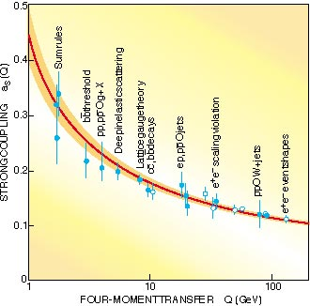
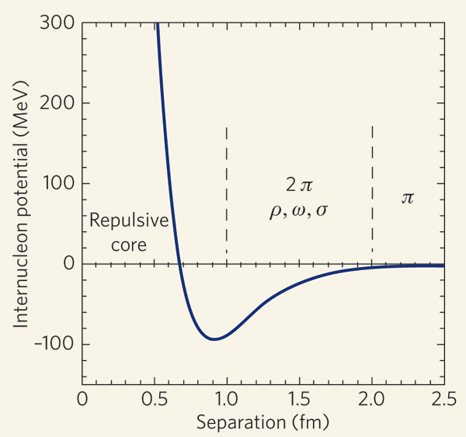
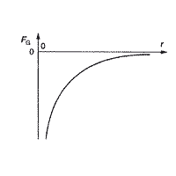
Quantum Chromo Dynamics
V ( r ) ∼ α_{s}(Q)/r +σ r
Small r (large Q): α_{s}(Q²) → 0, quarks behave as
free particles: Asymptotic Freedom.
Large r (small Q): the second term goes to infinity;
Infrared Slavery, No Free Quarks or Gluons.
Different from any other interaction we have
come across.
Escape velocity
Ionization potential
Binding energy
Achieved via quarks in 3 colours and 8 type of gluons , all of which carry colour charge.

Slide 3
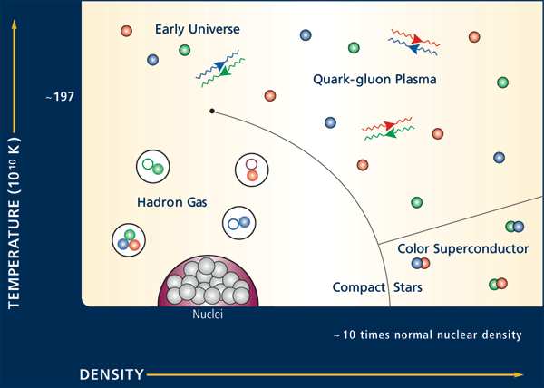
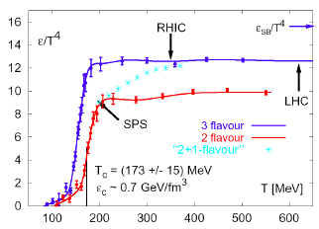
Quark Gluon Plasma
F. Karsch, Prog. Theor. Phys. Suppl. 153, 106 (2004)
Lattice QCD predicts transition to deconfined Quark Gluon Plasma phase at ~175MeV.
Goal of Relativistic Heavy Ion Collisions - to produce and characterize QGP.

Slide 4
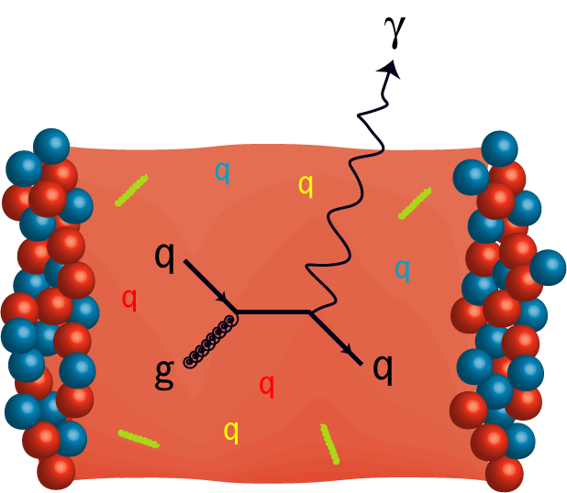
Thirty seven years ago:
E. L. Feinberg, Nuv. Cim. A 34 (1976) 391, pointed out that:
Direct photons; real or virtual are penetrating probes for the bulk matter produced in hadronic collisions, as
- They do not interact strongly.
  - They have a large mean free path.
Since then relentless efforts by researchers
from across the world have established these
as reliable probes of hot and dense matter.

Slide 5
The Information Content of EM Probes
Emission rates:
μ⁺
μ⁻
Photons:
Dileptons:
McLerran & Toimela,
PRD 31 (1985) 545;
Weldon, PRD 42 (1990) 2384;
Gale & Kapusta,
NPB 357 (1991) 65.
In- medium photon self energy:
Directly related to the in-medium vector spectral
densities!

Slide 6
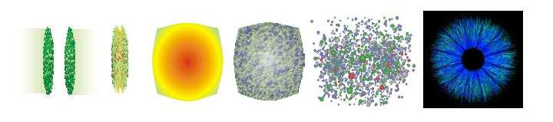



Single photons are penetrating probes. They are emitted at all stages and survive unscathed (α_{e} <<α_{s}). They are “historians” of the heavy ion collision!
A jet passing though QGP
Hadronic gas
Described by hydrodynamics
Mixed phase
QGP
Pre-equilibrium stage
Initial prompt photons
Different processes: different characteristic spectra!

Slide 7
Direct Photons
Different Sources - Different Slopes
Rate
Hadron Gas Thermal T_{f}
Photons are result of convolutions of the emissions from the entire history of the nuclear collision, so we need rates & a model for evolution.
QGP Thermal T_{i}
“Pre-Equilibrium”?
“New”
Jet Re-interaction √(T_{i}x√s)
Hydrodynamics.
Cascades.
Fire-balls.
Cascade+Hydro.
pQCD Prompt x√s
E_{γ}

Slide 8
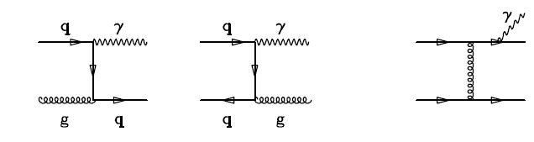
Partonic Processes for Production of Prompt Photons in Hadronic Collisions
Annihilation
Fragmentation
Compton
Calculate using NLO pQCD [with shadowing & scaling with T_{AA}(b) for AA,
partons remain confined to individual nucleons; do not forget the iso-spin! ]
The quarks will lose energy before fragmenting if there is QGP; suppressing the
fragmentation contribution.
See e.g., Jeon, Jalilian-Marian, Sarcevic, NPA 715 (2003) 795, “QM-2002”.

Slide 9
In the QGP we also have:
γ
Medium induced bremsstrahlung;
First calculated by Zakharov,
JETP Lett. 80 (2004) 1;
Turbide et al, PRC 72 (2005) 014905.
Zhang, Kang, & Wang, hep-ph/0609159.
Annihilation with scatterring; First calculated by Aurenche et al,
PRD 58 (1998) 085003.
Complete leading order results: Arnold, Moore, Yaffe, JHEP 0112 (2001) 009. NLO is at most 20% and similar in shape (see JHEP 1305 (2013) 010).

Slide 10
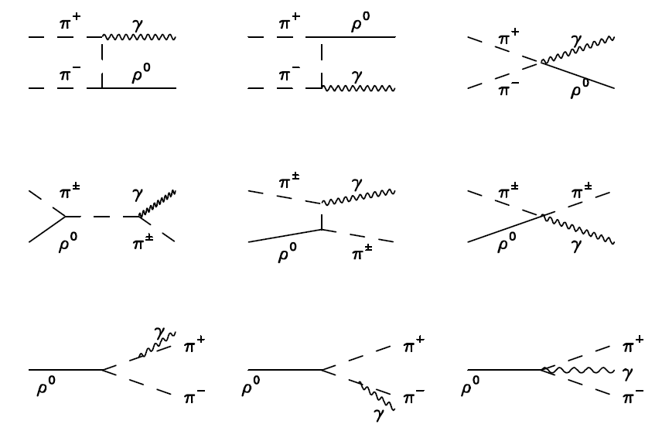
Examples of Hadronic Processes Involving π & ρ for Production of Photons
Include πρ→a₁→ πγ
Xiong et al, PRD 46 (1992) 3798;
Song, PRC 47 (1993) 2861.
Include baryonic processes.
Alam et al, PRC 68 (2003) 031901.
Medium modifications; (Series of
valuable papers, T and μ_{b})
Alam et al, Ann. Phys. 286 (2001)
159.
Include strange sector, massive
Yang- Mills theory, form-factors,
baryons, t-channel exchange of
ω mesons etc.
Turbide, Rapp, Gale, PRC 69
(2004) 014903.
First calculated by Kapusta, Lichard,
& Seibert, PRD 44 (1991) 2774.

Slide 11
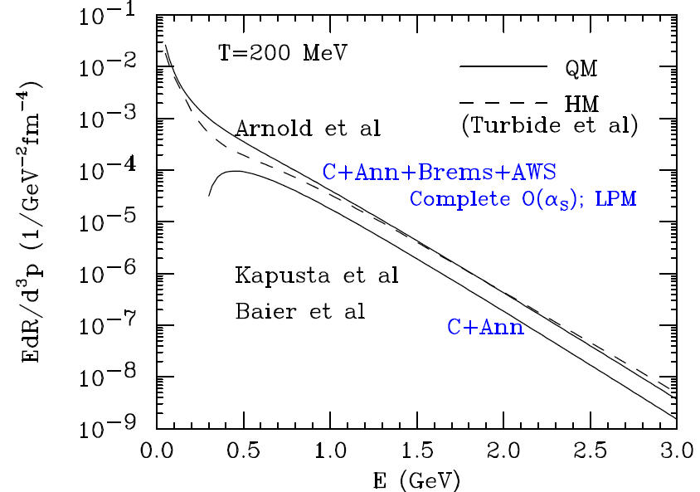
Complete Leading Order Rates from QGP &
Exhaustive Reactions in Hadronic Matter
Rates
are
similar !!
We need QGP
at higher T₀ for
golden photons
to clearly
outshine others.
Arnold, Moore, & Yaffe, JHEP 0112 (2001) 009.
Turbide, Rapp, & Gale, PRC 69 (2004) 014903.

Slide 12
Upper Limit of Single Photons, WA80
Ruled out hadronic gas with limited hadrons: π, ρ, ω, & η.
Pb+Pb@SPS
S. and Sinha, PRL 73 (1994) 2421;
Dumitru et al., PRC 51 (1995) 2166.
Sollfrank et al., Lee & Brown, Arbex et al., .
Cleymans, Redlich, & S.,
PRC 55 (1997) 1431.
However, n_{had} >> 2-3 /fm³ ! For No Phase Transition.

Slide 13
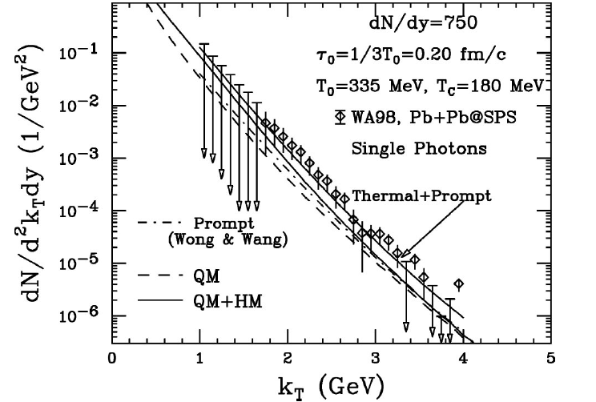
WA98: 2-loop → Complete O(α_{S}) for QGP
& πρa₁→ Exhaustive Hadronic Reactions for hadrons
S. & Sinha, PRC 64 (2001)034902 (R ).
S., PRC 71 (2005) 034905.
Hydrodynamics, QGP + rich EOS for hadrons
& accounting for the prompt photons

Slide 14
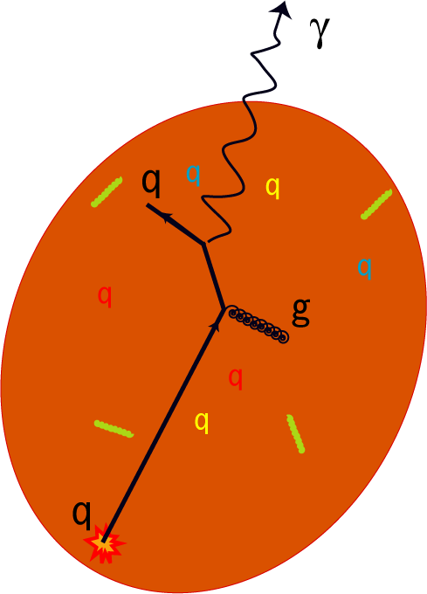
Interaction of hard-scattered parton with dense matter
Jet Photon Conversion
“External Probe!!”
Hard scattered parton
Fries, Mueller, & S. , PRL 90 (2003) 132301.

Slide 15
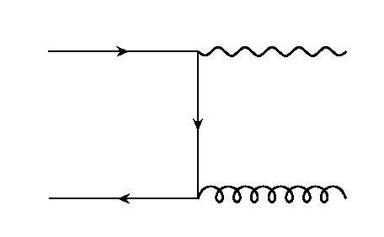
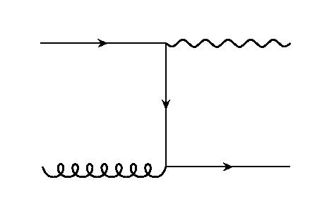
Jet-Initiated EM Radiations from QGP
Annihilation and Compton processes peak in forward and backward directions:
one parton from hard scattering, one parton from the thermal medium; cutoff p_{γ,min} > 1 GeV/c.
photon carries momentum of the hard parton
Jet-Photon Conversion
This puts photon production and jet-quenching on the same page!!

Slide 16
Jet-Photon Conversion: Rates
Annihilation and Compton rates:
thermal medium:
quark (-jet) distribution

Slide 17
Photons from Passage of Jets through QGP
Fries, Mueller, & S., PRL 90 (2003) 132301.
This “bremsstrahlung” contribution will be suppressed due to E-loss and
there will be an additional jet-induced bremsstrahlung, which is also
similarly suppressed, leaving the jet-conversion photons as the largest
source for p_{T} = 4-10 GeV.

Slide 18
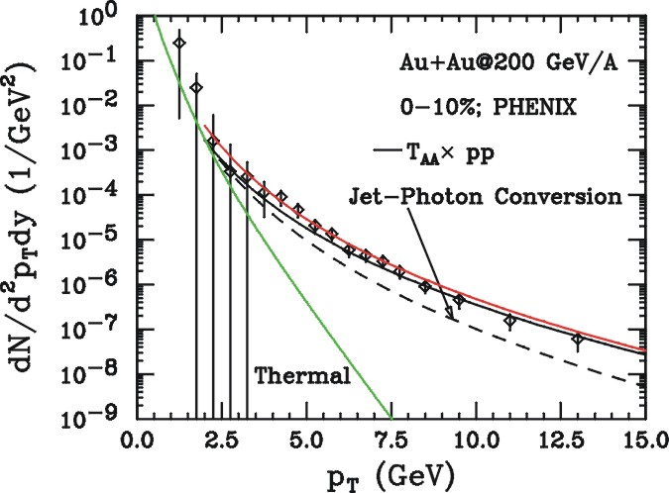
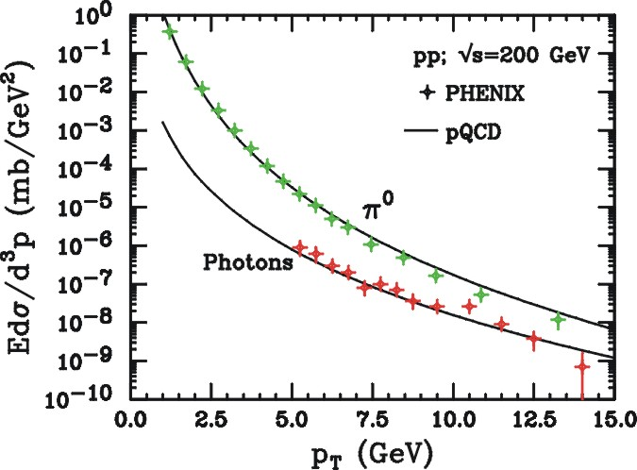
FMS Results: Comparison to Data
  calibrate pQCD calculation of
  direct and Bremsstrahlung
  photons via p+p data:
for p_{t}<6 GeV, FMS photons give significant contribution to photon spectrum: 50% @ 4GeV.
Proper Isospins & Shadowing !!!
Fries, Mueller, & S., PRC 72 (2005) 041902( R).

Slide 19
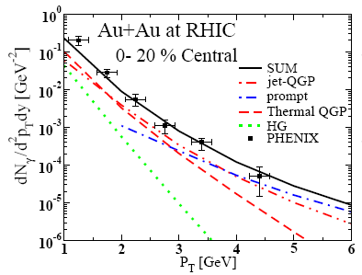
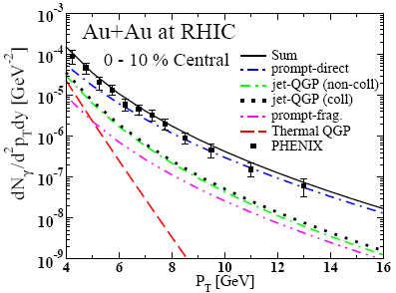
AMY and One-Stop Treatment of
Jet-Quenching and Jet-Initiated Photons
Turbide, Gale, Frodermann, & Heinz, hep-ph/0712.732 (Talk by Gale)
This supersedes Turbide, Gale, Jeon, & Moore, PRC 72 (2005) 014906;
which used AMY but all the processes were calculated using hard spheres and ignoring transverse expansion.

Slide 20
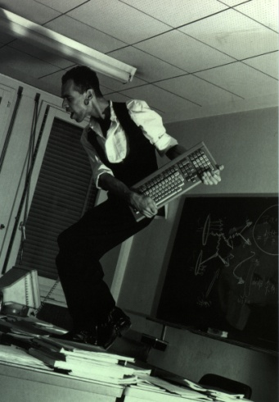
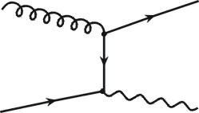

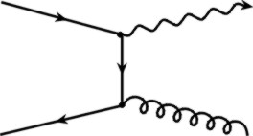
Parton Cascade Model
Embedded in the partonic cascades
Renk, Bass, & S., PLB 632 (2006) 632.
LPM plays a significant role.
Bass, Mueller, & S.,
PRC 66 (2002) 061902 (R).

Slide 21
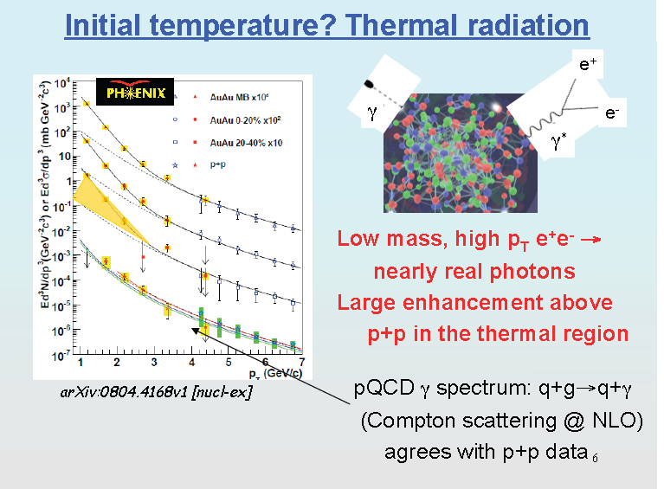
Phys.Rev.Lett.104:132301,2010

Slide 22
Thermal photons from Au+Au@RHIC
d’Enterria & Peressounko,
EPJC 46 (2006) 451.

Slide 23
Elliptic Flow of Thermal Photons:
Measure Evolution of Flow !
Adult life
Late times
Early times
FIRST
Chatterjee, Frodermann, Heinz, and S., PRL 96 (2006) 202302.

Slide 24
Impact Parameter Dependence of v₂

Slide 25
Elliptic Flow of Thermal Dileptons: Measure Evolution of Flow !
Chatterjee, Heinz, Gale, & S., PRC 75, 054909 (2007).
FIRST

Slide 26
Elliptic flow of thermal photons
Chatterjee et al.

Slide 27
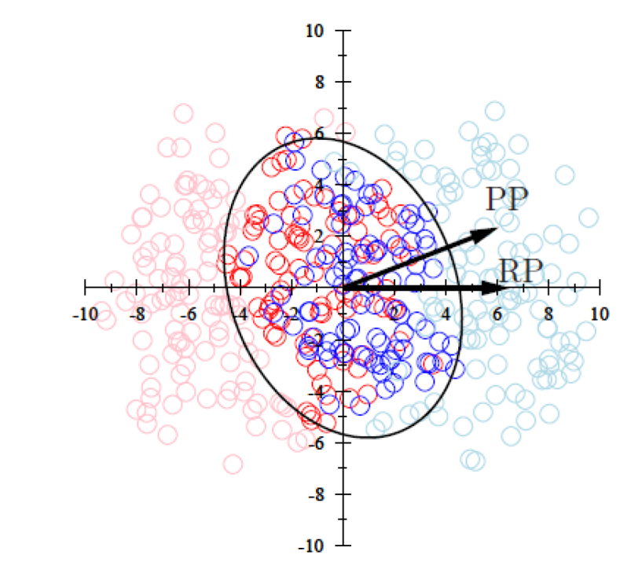
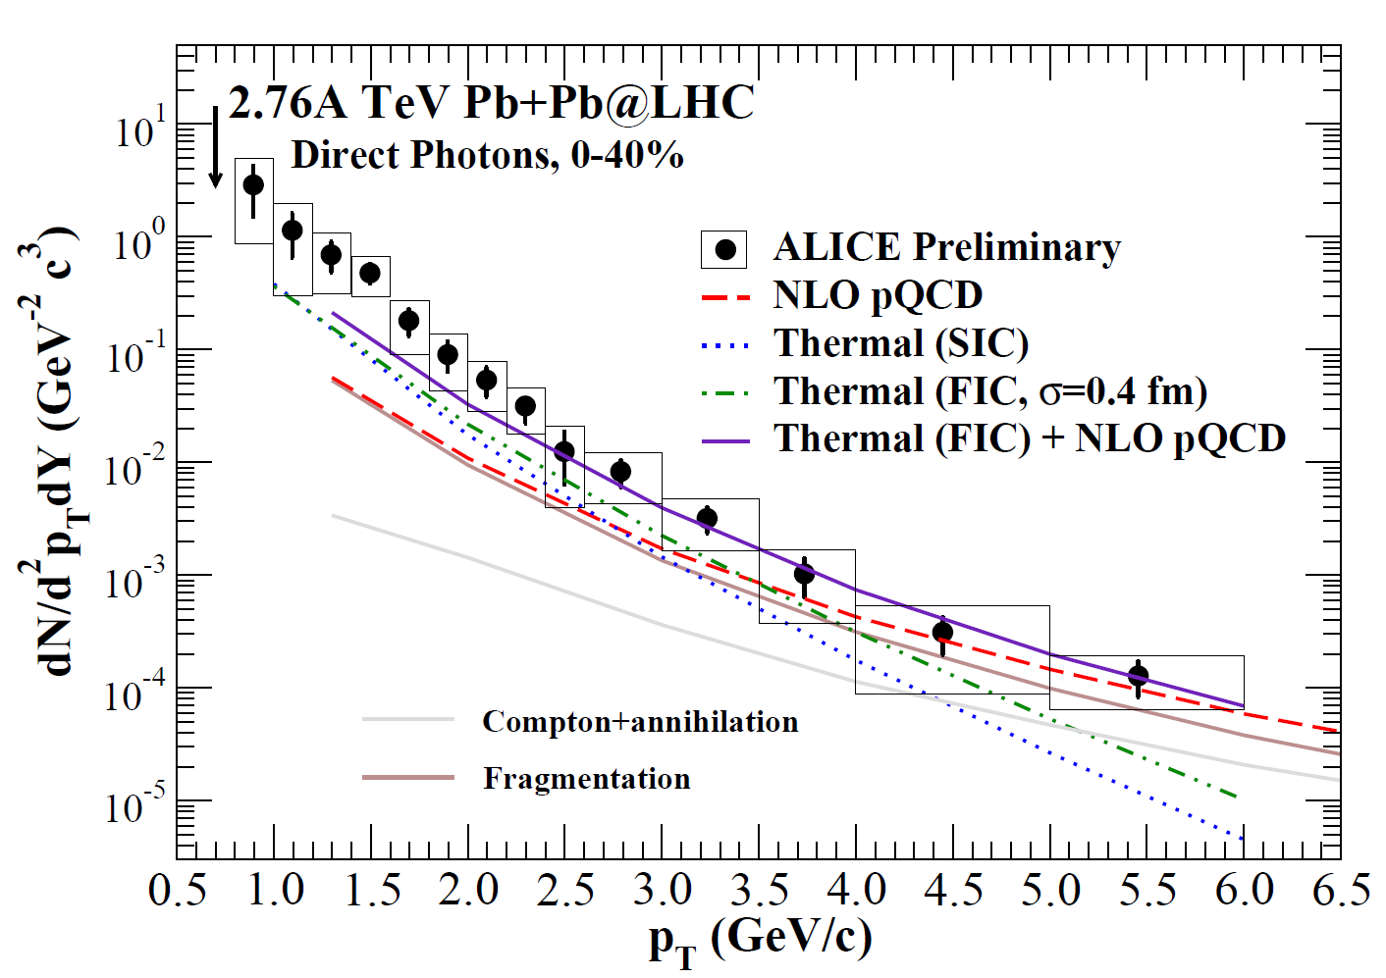
Event-by-event fluctuating initial density distribution
The ‘hotspots’ in the fluctuating events produce more high p_{T} photons compared to a smooth initial state averaged profile.
arXiv:1305.6443
Fluctuation size
parameter σ=0.4 fm

Slide 28
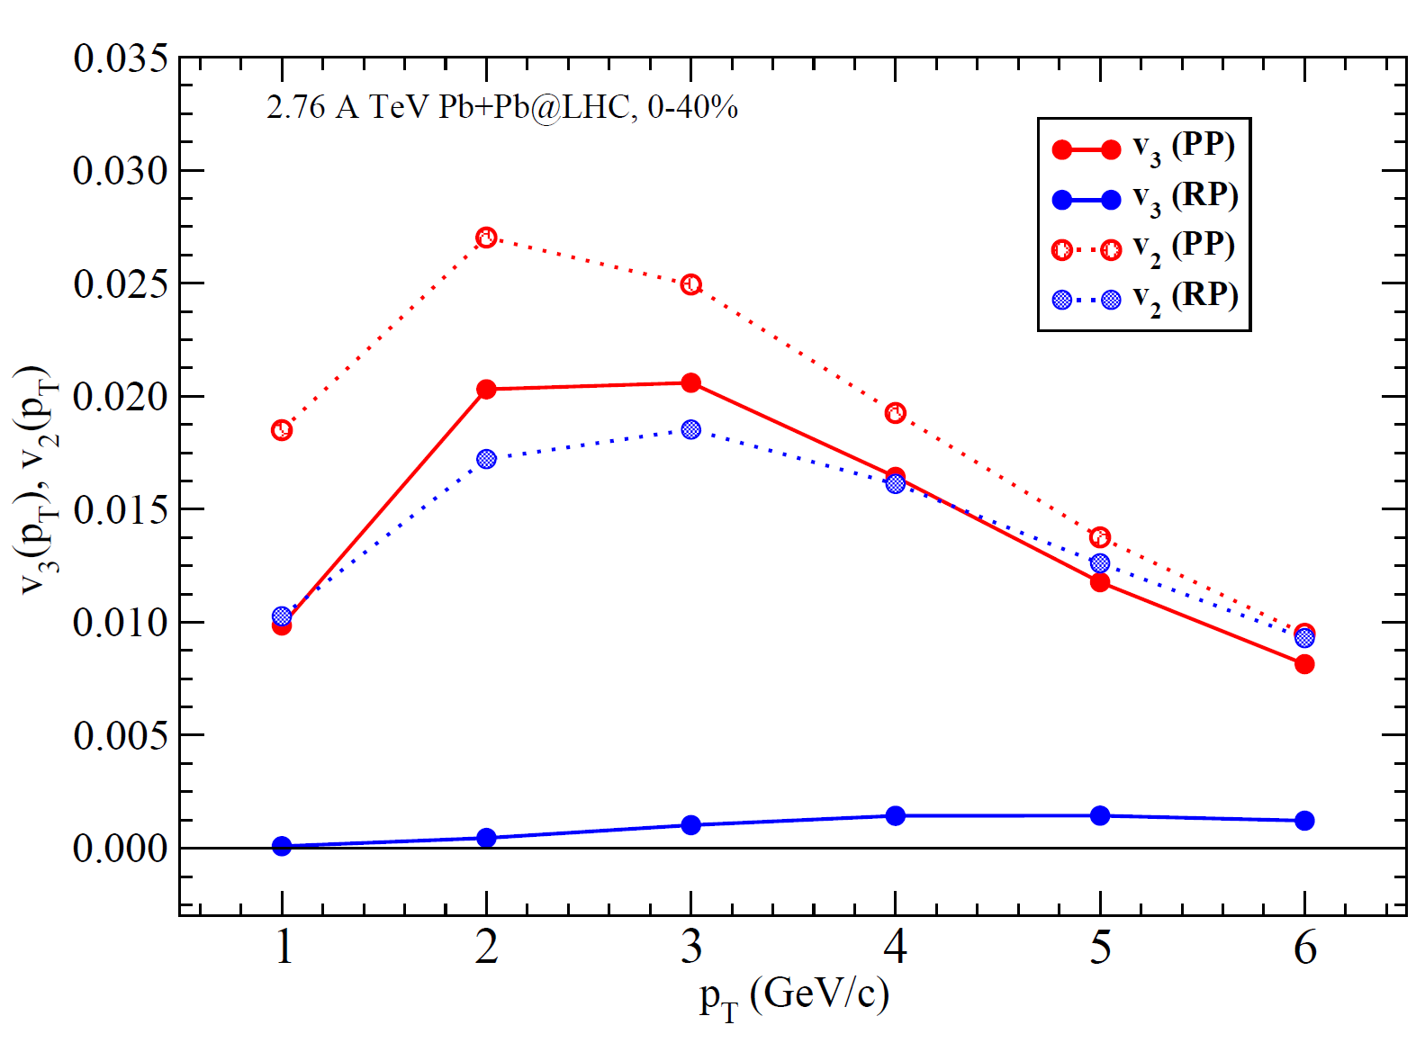
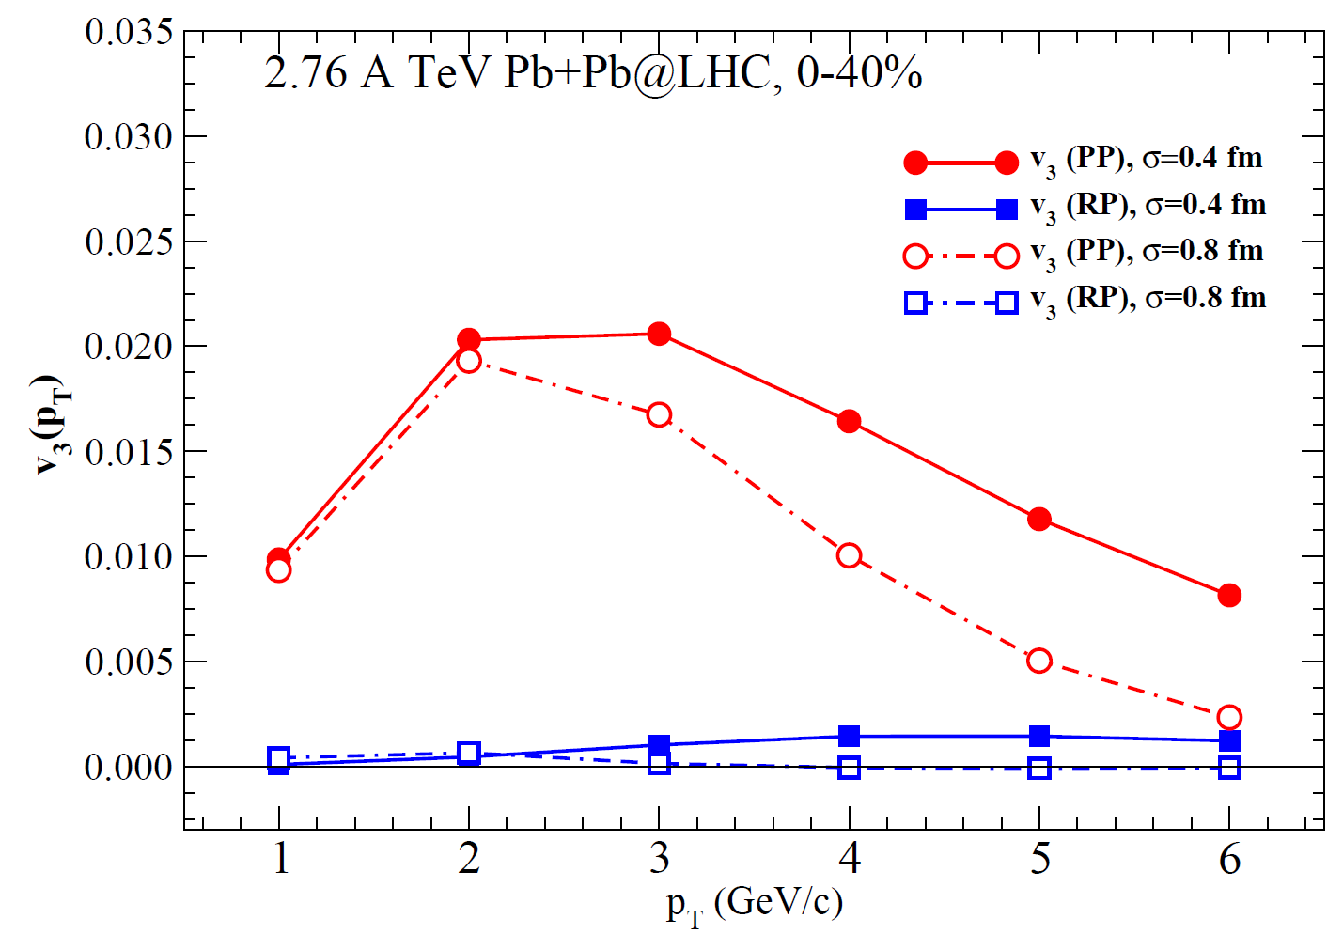
Triangular flow of thermal photons
v₃ (p_{T}) for 2.76A TeV Pb+Pb@ LHC
σ dependence of v₃
Chatterjee, Holopainen, DKS [in preparation]

Slide 29
Intensity Interferometry of Thermal Photons

Slide 30
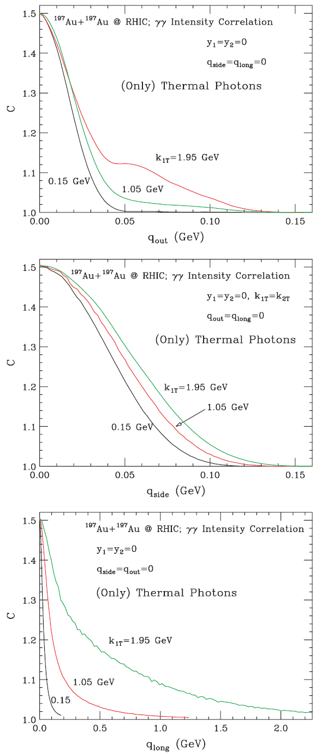
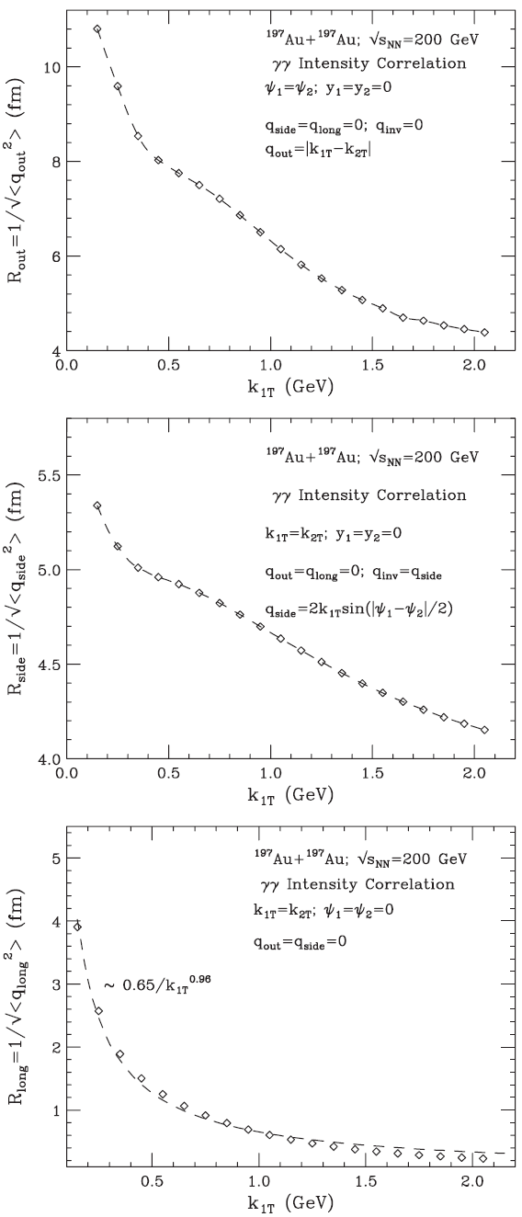
200A GeV Au+Au@RHIC
γγ intensity correlation
C(q_{out,}q_{side}=q_{long}=0)
R_{out} (K_{1T})
q_{side}=q_{long}=0
C(q_{side,}q_{out}=q_{long}=0)
R_{side} (K_{1T})
q_{out}=q_{long}=0
C(q_{long,}q_{out}=q_{side}=0)
R_{long} (K_{1T})
q_{out}=q_{side}=0
DKS, PRC 71 (2005) 034905.

Slide 31
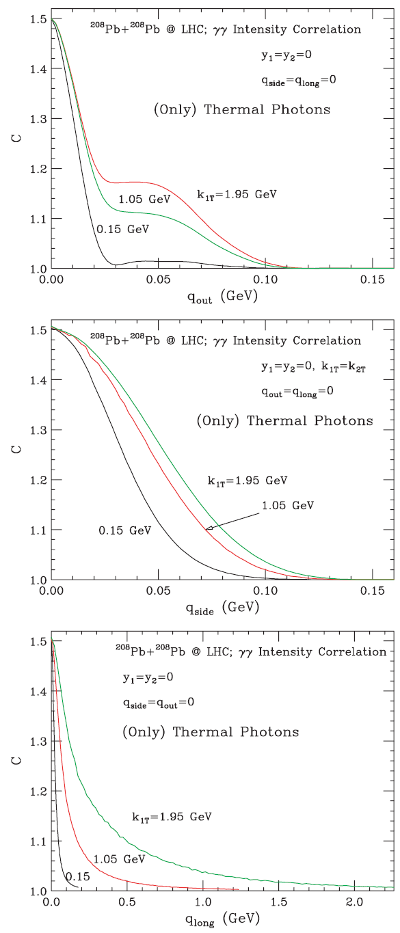
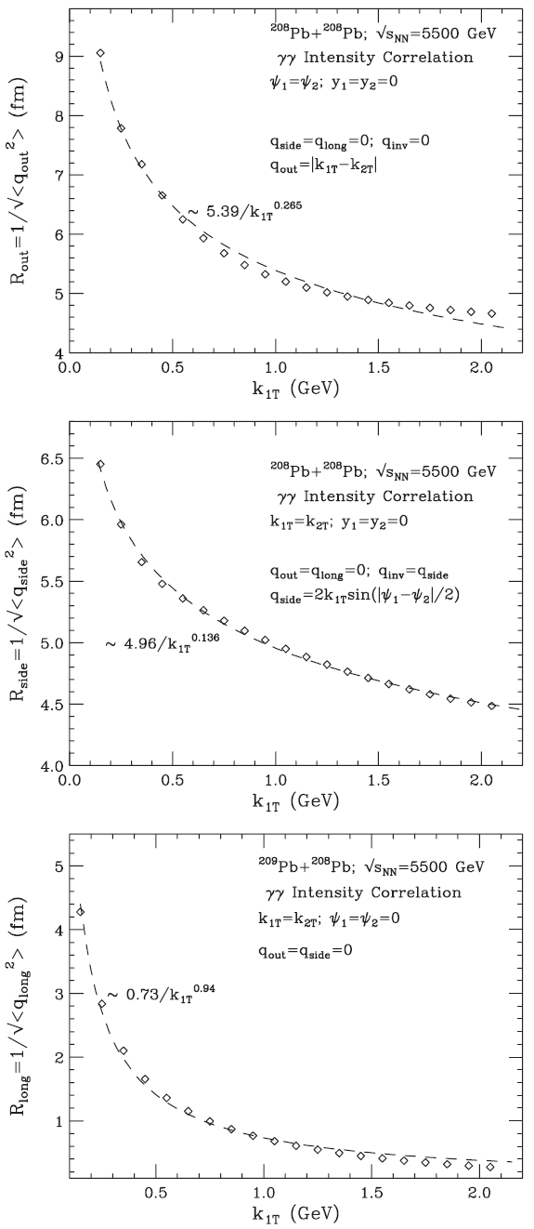
5.5A TeV Pb+Pb@LHC
γγ intensity correlation
C(q_{out,}q_{side}=q_{long}=0)
R_{out} (K_{1T})
q_{side}=q_{long}=0
C(q_{side,}q_{out}=q_{long}=0)
R_{side} (K_{1T})
q_{out}=q_{long}=0
C(q_{long,}q_{out}=q_{side}=0)
R_{long} (K_{1T})
q_{out}=q_{side}=0
DKS, PRC 71 (2005) 034905.

Slide 32
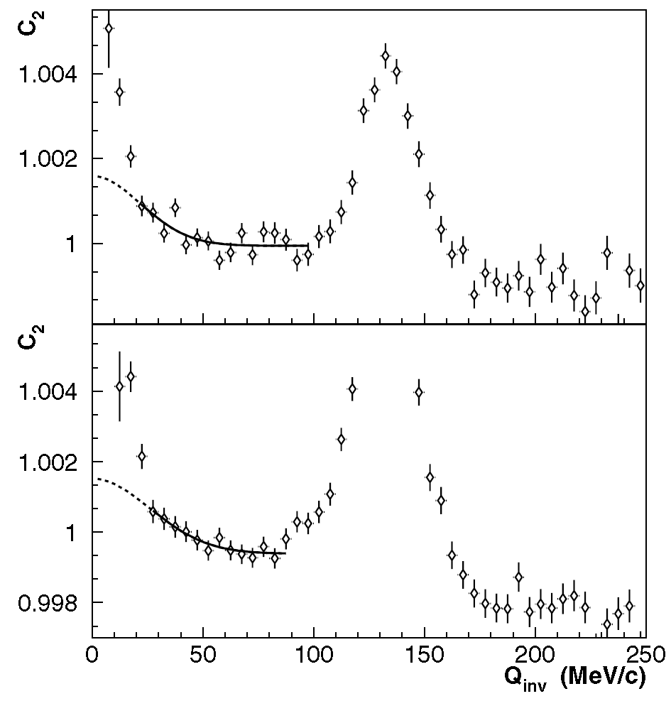
The two-photon correlation function for average photon momenta 100 < K_{T} < 200 MeV/c (top) and 200 < K_{T} < 300 MeV/c (bottom). The solid line shows the fit result in the fit region used (excluding the π⁰ peak at Q_{inv} ≈ m_{π0} ) and the dotted line shows the extrapolation into the low Q_{inv} region where backgrounds are large.
M. M. Aggarwal et al., [WA98 collaboration] PRL 93, 022301 (2004)

Slide 33
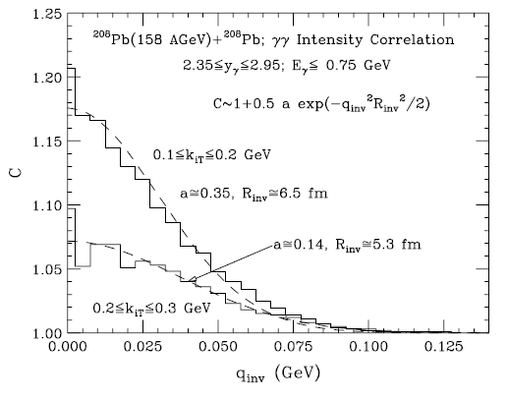
Intensity Interferometry of Thermal Photons @SPS
A one-dimensional analysis of the correlation function
C is performed in terms of the invariant momentum difference as follows:
WA98 measures R_{inv} as 8.34 ± 1.7 fm and 8.63 ± 2.0 fm, respectively
For y₁=y₂=0 and ψ₁=ψ₂=0, q_{side}=q_{long}=q_{inv}=0,
but q_{out}=k_{1T}-k_{2T} .ne.0
DKS, PRC 71 (2005) 034905.

Slide 34
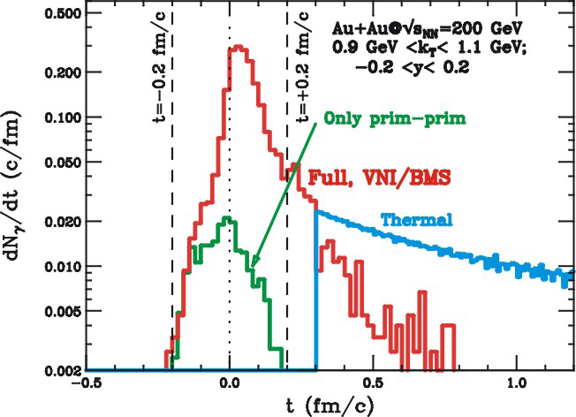
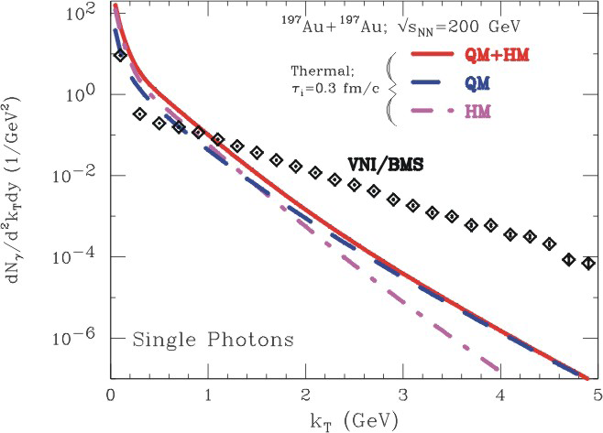
pre-equilibrium contributions are easier identified at large p_{T}.
window of opportunity above p_{T} = 2 GeV.
at 1 GeV, need to take thermal contributions into account.
short emission time in the PCM, 90% of photons before 0.3 fm/c
hydrodynamic calculation with τ₀=0.3 fm/c allows for a smooth continuation of emission rate
Bass, Mueller, & DKS, PRL 93 (2004) 16230

Slide 35
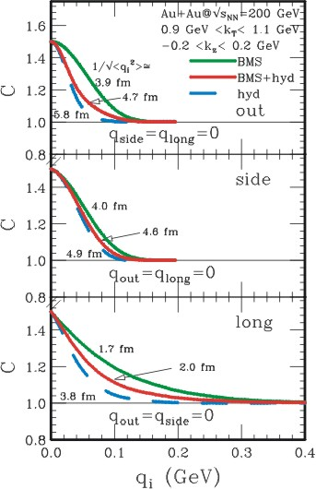
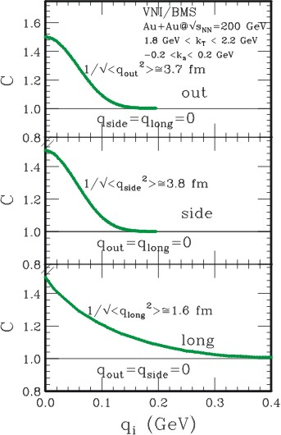
Photons: HBT Interferometry
p_{t}=2 GeV: pre-thermal photons dominate, small radii
p_{t}=1 GeV: superposition of pre- & thermal photons: increase in radii

Slide 36
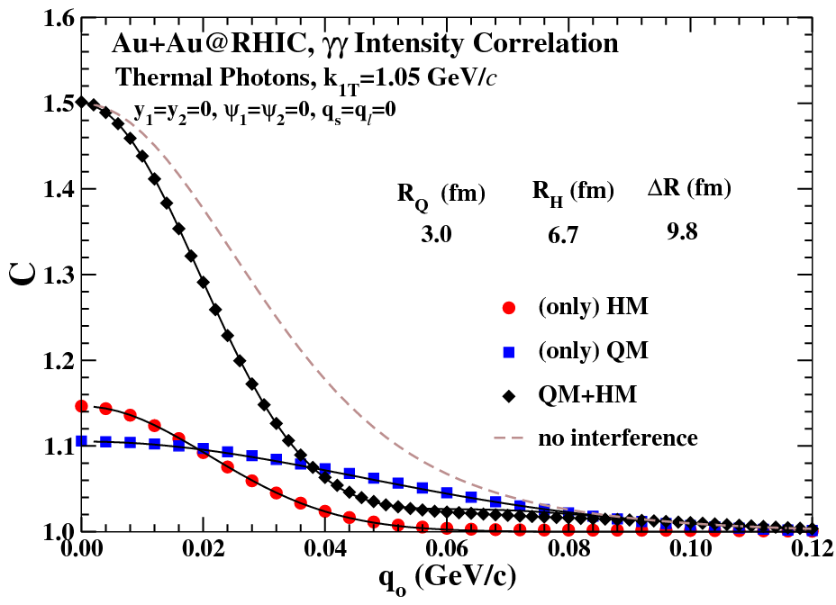
Outward correlation function of thermal photons
for 200A GeV Au+Au collision at RHIC

Slide 37
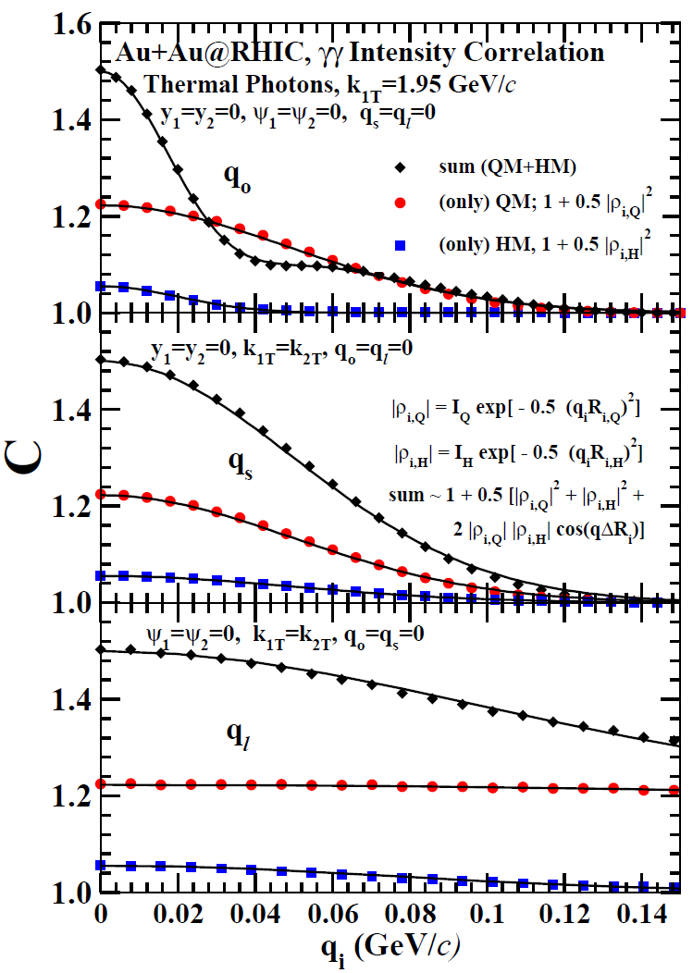
The outward, sideward, and longitudinal correlation functions for thermal photons produced in central collision of gold nuclei at RHIC taking τ₀ = 0.2 fm/c. Symbols denote the results of the calculation, while the curves denote the fits.
Correlation function in the two
phases can be approximated as
where,
i=out, side, and long
α= quark matter (Q) or hadronic matter (H)
DKS and R. Chatterjee; arXiv: 0907.1360

Slide 38
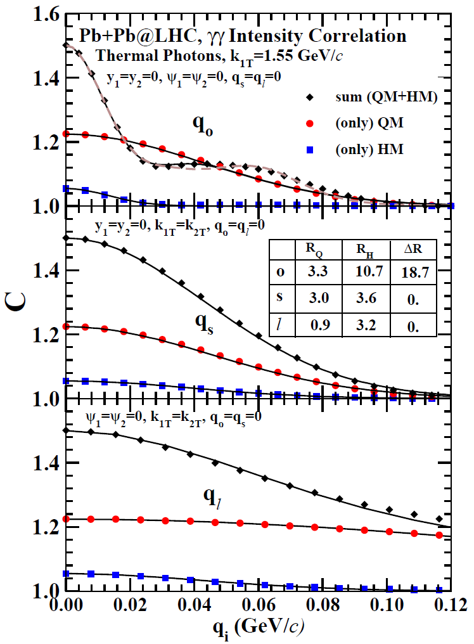
The outward, sideward, and longitudinal correlation functions for thermal photons produced in central collision of lead nuclei at LHC taking τ₀ = 0.2 fm/c. Symbols denote the results of the calculation, while the curves denote the fits.
DKS and R. Chatterjee
arXiv: 0907.1360

Slide 39
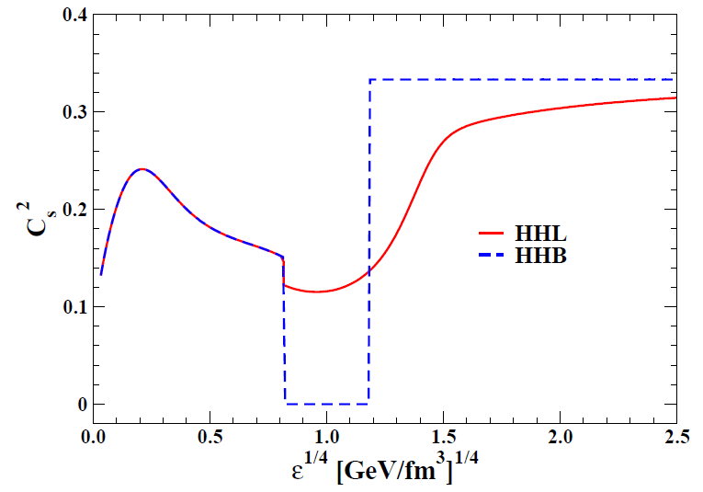
How Sensitive Are We
to
Equation of State?
(i) Volume corrected hadron
and Hagedorn resonance gas matched with a Bag Model ((HHB).
(v) Volume corrected hadron and Hagedorn resonance gas matched with Lattice calculations (HHL).
Speed of sound

Slide 40
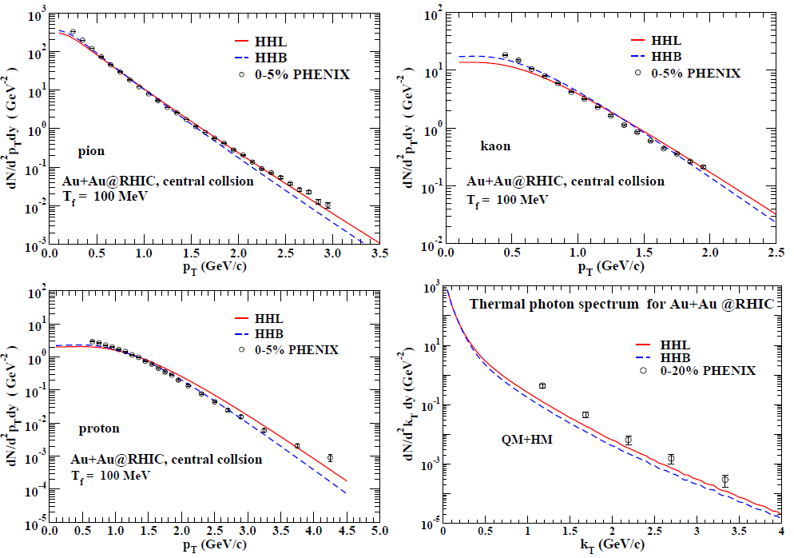
Pion, kaon, proton and thermal photon p_{T} spectra at RHIC for the equations of state, HHB and HHL. All the calculations are for impact parameter b=0 fm.

Slide 41
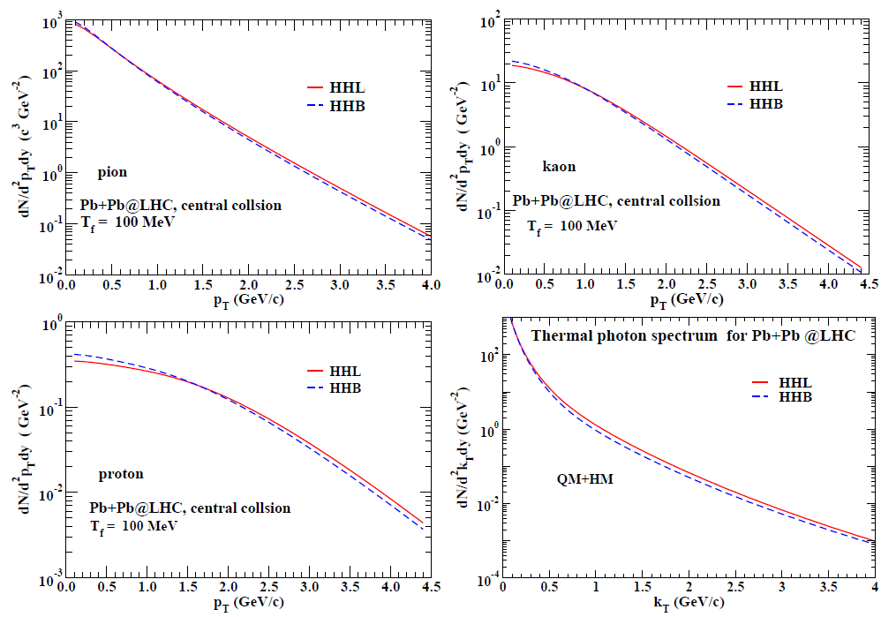
Pion, kaon, proton and thermal photon p_{T} spectra at LHC for the equations of state, HHB and HHL. All the calculations are for impact parameter b=0 fm.

Slide 42
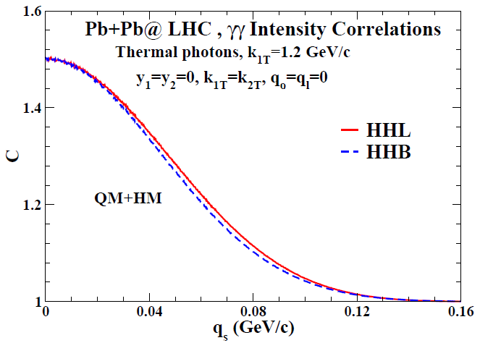
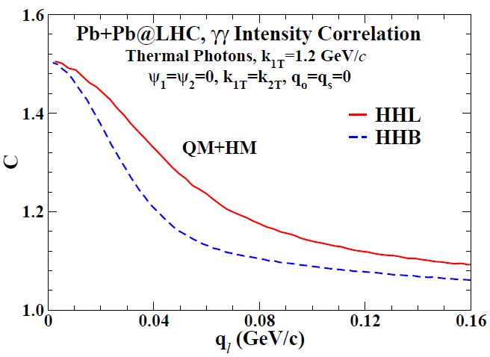
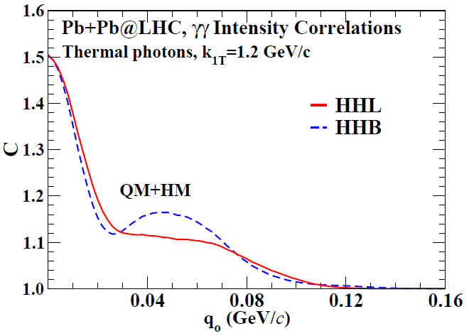
Determine Equation of State of strongly interacting matter.
Discover interference of photons from quark matter and hadrons, predicted by
DKS and R. Chatterjee.
LHC

Slide 43
Conclusions
The discovery of quark gluon plasma has provided confirmation of one of the most spectacular predictions of QCD- the theory of strong interactions.
Single photons, provide interesting details of initial stage of the plasma and its dynamics.
The initial state in these collisions is hot ~300-500 MeV and dense, 20-100 GeV/fm³, similar to the matter in early universe.

Slide 44


Slide 45
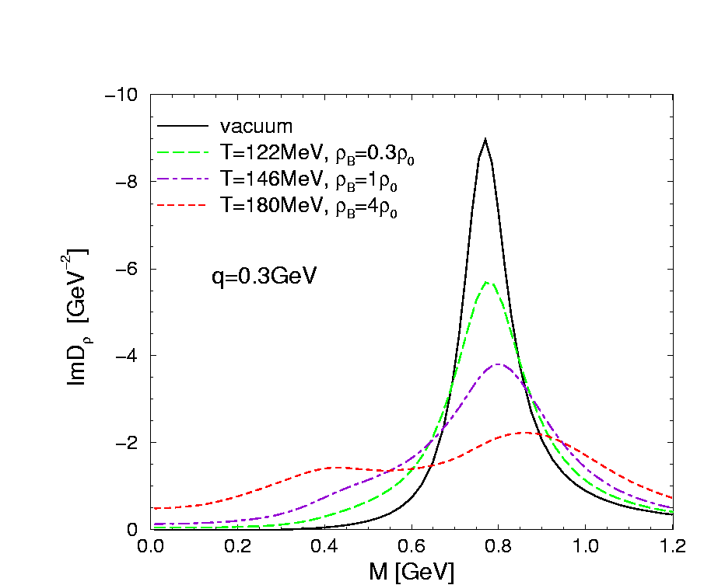
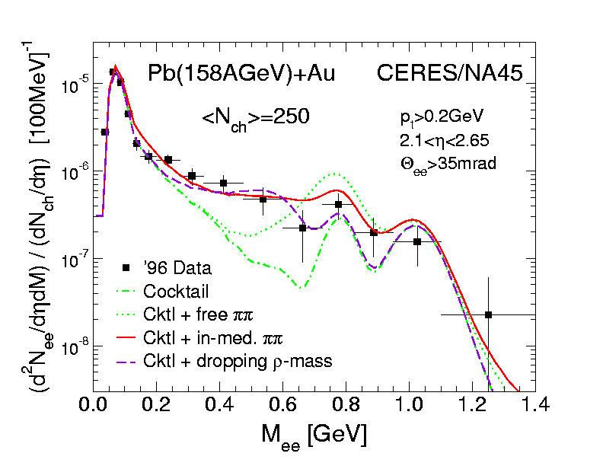
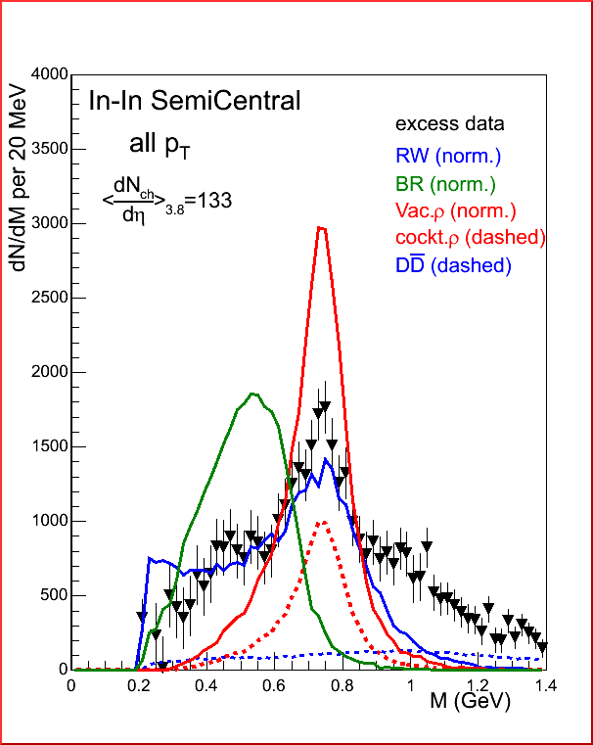
Dropping m_{ρ} vs. increasing Γ_{ρ}
Vastly
Improved
Data
RW
ω
van Hees and
Rapp,
PRL 97
(2006) 102301.
φ
Only brodening of ρ (RW) observerd, no mass shift (BR)

Slide 46
Passage of Jets Through QGP

Slide 47
PQCD framework: Jets
Medium modified fragmentation functions:
Q²
D⁽¹⁾
L
q
q
g
F⁽¹⁾
F⁽²⁾
Measured medium property:
D⁽²⁾
Factorization:
⊗
⊗
⊗

Slide 48
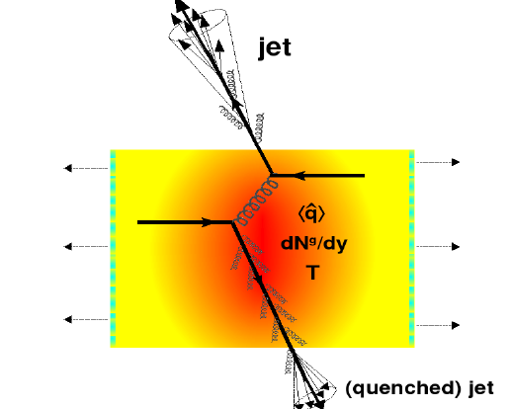
Jet quenching is considered as one of the most promising signatures of formation of QGP
It is defined as the suppression of high momentum particle
spectra, arising due to energy loss of partons prior to fragmentation.
It is quantatively measured through the nuclear modification factor R_{AA}, which is defined as:

Slide 49
Confirmation of High Density Matter

Slide 50
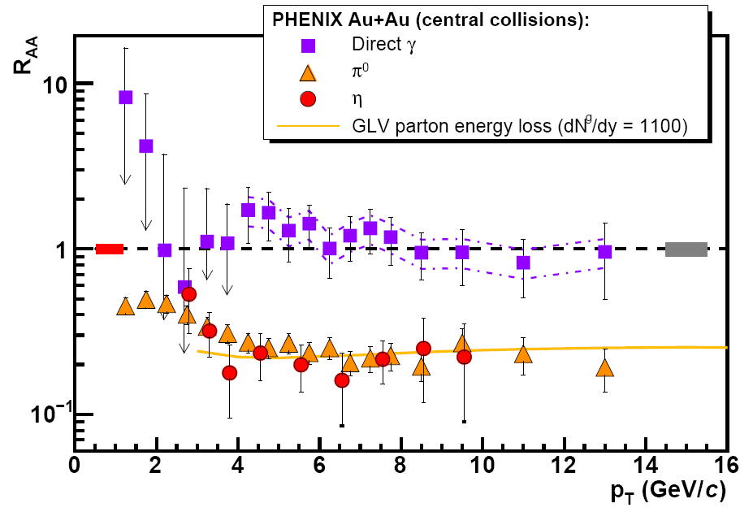
A final state effect !

Slide 51
Photon tagged jets
γ-jet correlation
  E_{γ} = E_{jet}
  Opposite direction
Direct photons are not affected
by the medium
Parton in-medium-modification
through the fragmentation function
D(z), z = p^{hadron}/E_{γ}
γ
Golden Channels :
g + q → γ + q (Compton)
q + q → γ + g (Annihilation)
p_{T} > 10 GeV/c
Wang, Huang, & Sarcevic, PRL 77 (1996) 231.
See also, Renk, PRC 74 (2006) 034906, for
differentiation of mechanisms of E-loss,
and several results at this meeting.

Slide 52

Dilepton vs. photon tagged jets
γ*
Photon tagged jets:
Difficult measurement:
At low p_{T}, π⁰ → γγ large background.
At higher p_{T}, background problem better
but opening angle becomes smaller.
Compton
Dilepton tagged jets:
Lower yield but lower back-ground.
Charm and beauty decay could be identified.
M and p_{T}: two handles!
Gold plated standard via Z⁰ tagging at LHC.
S., Gale, & Awes, PRC 67 (2003) 054904;
Lokhtin et al, PLB 599 (2004) 260.

Slide 53
Azimuthal tagging of jets with photons/dileptons
Jet
Jets of a given enegy traversing
different path-lengths!
Very Valuable.
E_{γ}=E_{jet}
γ
E_{γ}=E_{jet}

Slide 54

Neutral pion production for p-p collisions at RHIC
S. De and DKS,
arXiv:1107.5659
Next-to- leading order Ο(α_{s}³) calculations are used.
CTEQ4M parton distribution function.
BKK fragmentation function.

Slide 55
While calculating particle production in AA collisions, we include:
Nuclear shadowing. (EKS98 parameterization)
Energy loss of partons in the medium.
Average path length traversed by the parton.
The average path length L(ϕ,b) traversed by a parton for non-central
collisions of impact parameter b.
We follow a simple phenomenological model based on the formalism of Baier et.al. and first used by S. Jeon et al at RHIC energies, to estimate parton energy loss.

Slide 56
The formation time of the radiated gluon:
ε - energy loss per collision, λ_{a}- mean free path:
BH limit
LPM limit
Coherence limit
where

Slide 57
The probability for a parton to scatter n times before
it leaves the medium
The effect of energy loss of partons and multiple scatterings
are implemented through the modification of D_{c/h}(z,Q²) following the
model of Wang-Huang-Sarcevic.
where,
,
and

Slide 58




R_{AA} of neutral pions for Au-Au collisions at RHIC
BH regime

Slide 59




LPM regime
S. De and D. K. S. , arXiv:1107.5659

Slide 60




Complete Coherence Regime

Slide 61


R_{AA} of charged hadrons for Pb+Pb @ 2.76 ATeV : CMS preliminary

Slide 62

Centrality dependence of dE /dx at RHIC & LHC
Taking the case of parton energy loss in the complete coherence regime, - dE/dx = ε / λ
The concerned partons having
at RHIC and
at LHC
Pb+Pb @ 2.76 ATeV
0-5%, ALICE coll.
<L>∼ 6.90 fm
-dE/dx =2.4 GeV/fm
We see that the energy lost by the partons,

Slide 63

Heavy Quark Propagation
Initial Fusion
Jet-jet interaction
Thermal production
Passage of jets through Quark Gluon Plasma.
NLO effects.
Back to back correlations
dE/dx

Slide 64
Energy and flavour dependence of parton energy loss
Refs: JPG 39, 095003 (2012); 015001 (2012); arXiv: 1112.2492
Bethe- Heitler Limit of Incoherent Radiation:
LPM Limit of Coherent Radiation:
RHIC:
LHC:

Slide 65
Back up slides

Slide 66

Low, Intermediate, & High Mass Dileptons
Low-mass:
Medium modified spectral density
Intermediate mass:
Radiation from QGP
High mass:
J/ψ etc., suppression
Correlated Charm/Bottom Decay.
The same model
should explain both:
Single Photons and
Dileptons.

Slide 67
If I had more time:
Intensity Interferometry of direct photons
D. K. Srivastava, PLB 307(1993)1.
D. K. Srivastava and J. I. Kapusta, PRC 48 (1993) 1335.
D. K. Srivastava, PRD 49 (1994) 4523.
S. A. Bass, B. Muller, D. K. Srivastava, PRL 16 (2004) 162301;
D. K. Srivastava, PRC 71 (2005) 034905.
D. K. Srivastava & R. Chatterjee, PRC 80(2009) 054914.
S. De, R. Chatterjee, D. K. Srivastava, J. Phys. G37 (2010) 115004.

Slide 68


Most Reliable Historians of Ancient India
A slight
digression.
“A Record of Budhist Kingdoms”:
Fa Hien (337-422 AD):
visited India during 399-414 AD.
“Journey to the Western World”:
Huen Tsang (Yuoan Chwang) 603-664 AD:
visited India during 630-645 AD.
They traversed India like photons and dileptons and left most valuable records!!

Slide 69
Most Reliable Historians of Ancient India
A slight
digression.
“A Record of Budhist Kingdoms”:
Fa Hien (337-422 AD):
visited India during 399-414 AD.
“Journey to the Western World”:
Huen Tsang (Yuoan Chwang) 603-664 AD:
visited India during 630-645 AD.
They traversed India like photons and dileptons and left most valuable records!!

Slide 70

Intermediate Mass; NA50
Kvasnikova, Gale, & Srivastava,
PRC 65 (2002) 064903.
Acceptance and detector resolution
accurately modeled.
See also Rapp & Shuryak, PLB 473 (2000) 13.

Slide 71


Photons: pre-equilibrium vs. thermal
pre-equilibrium contributions are easier identified at large p_{t}:
window of opportunity above p_{t}=2 GeV
at 1 GeV, need to take thermal contributions into account
short emission time in the PCM, 90% of photons before 0.3 fm/c
hydrodynamic calculation with τ₀=0.3 fm/c allows for a smooth continuation of emission rate
caveat: medium not equilibrated at τ₀

Slide 72
Photons: HBT Interferometry
p_{t}=2 GeV: pre-thermal photons dominate, small radii
p_{t}=1 GeV: superposition of pre- & thermal photons: increase in radii
Bass, Mueller, & Srivastava, PRL 93 (2004) 16230;
Srivastava, PRC 71 (2005) 034905.

Slide 73
Elliptic Flow of Thermal Dileptons

Slide 74

Elliptic Flow of Decay Photons
δ ~0.2 GeV
Layek, Chatterjee, Srivastava,
PRC 74 (2006) 044901.

Slide 75

Theoretical Interpretation of High-p_{T} π⁰ Suppression
Large suppression implies large energy loss. Model calculations indicate high gluon densities dN_{g}/dy ~ 1100
Implies large energy density (as do also E_{T} measurements) ε > 10 GeV/fm³ well above critical energy density ε_{crit} ~ 1 GeV/fm³
Strong Suppression!

Slide 76
QGP or Hot Hadrons? Enter WA98
QGP
+ prompt γ
v₀.ne.0
Hadrons
(m_{had} →0 at
T_{i}=205 MeV
for all
hadrons)
Huovinen et al, PLB 535 (2002) 109.
QGP or hadrons ( n_{had} >> 1/fm³
at T_{i} = 245-275 MeV)
Alam et al, PRC 63 (2001) 021901 ( R).

